Slide 1
NE 795: Advanced Reactor Materials
Fall 2023
Dr. Benjamin Beeler

Slide 2
Housekeeping
Class eval is up, please fill this out: http://go.ncsu.edu/cesurvey
Forgot to mention, was a 5-point curve on test 3 scores, so add 5 to your grade for your ‘actual’ test grade
I will also send out a google form survey
  will be anonymous, but forward me the confirmation that you filled out the form, and you will get +5 on the final exam
Last exam on Nov. 30
Next Tuesday will be an ‘other stuff’ lecture, not covered on exam
Then we are done

Slide 3
Last Time
Blister testing is used as a safety test to determine temperature limits of safe fuel operation, with typical BTEs around 450-550C
U-Mo dispersion fuels allow for greater U density than U-Si fuels
Mo stabilizes the gamma phase, and the gamma is additionally stabilized under irradiation
Fuel swelling is critical in U-Mo fuels, with the unique feature of a fission gas superlattice
Subsequent recrystallization leads to breakaway swelling
Addition of Si can suppress the interaction layer formation in U-Mo particles
Started transition to monolithic foil fuel

Slide 4
U-Mo Microstructure
The microstructure of U-Mo foil depends on feedstock impurity content, the starting condition of the fuel coupon, and the rolling schedule
The size and morphology of the grains depend on the thermo-mechanical treatments that are used during fuel-plate fabrication
Molybdenum depleted and enriched regions in the as-cast microstructure resulting from solidification form elongated features during rolling
Bands of differing Mo concentration can be observed in the final foil
Decomposition of the original gamma phase results in a lamellar structure comprised of alpha-U and gamma'-phase
These lamellar structures can manifest themselves as bands within the foil microstructure, or as decomposed regions along the grain boundaries

Slide 5
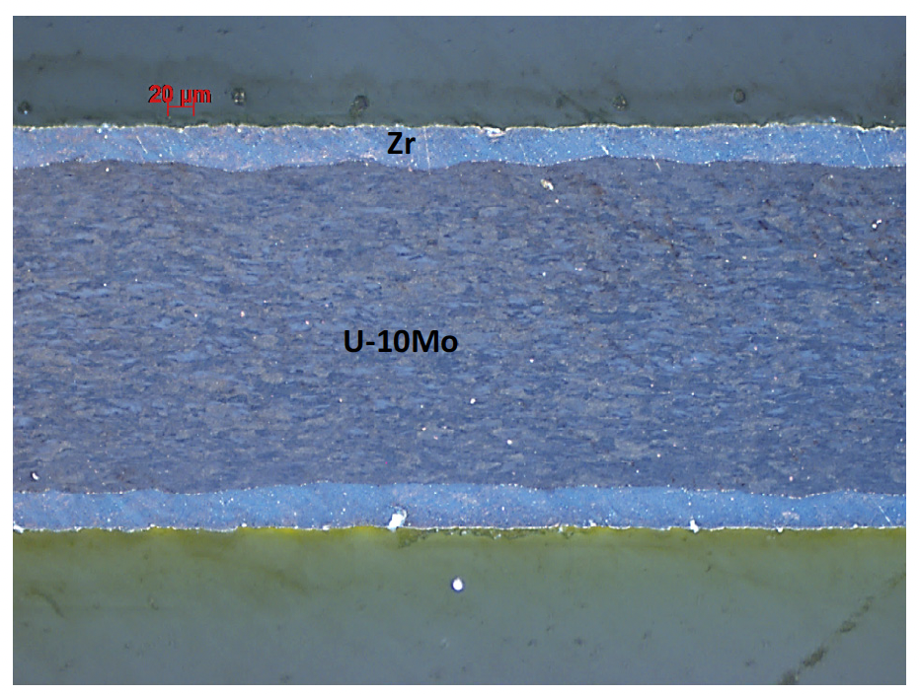
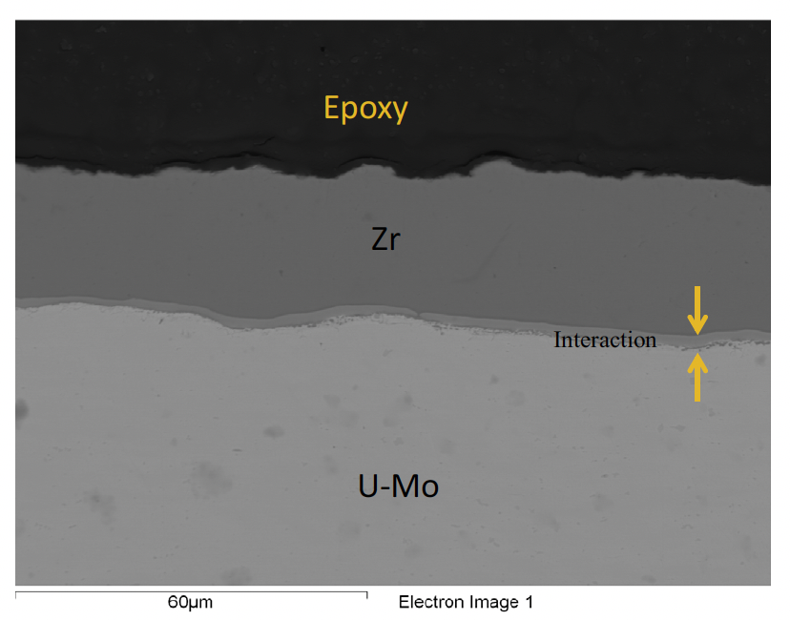
Interdiffusion Barrier
A key feature that defines the irradiation performance of monolithic fuel is the interface between the fuel meat and the cladding
The approach was to minimize the interaction between the U-Mo fuel foil and the cladding through introduction of a Zr diffusion barrier
A barrier thickness of 25 μm was selected to exceed the maximum fission fragment recoil range (~9 μm) and to allow for variability in the manufacturing process

Slide 6
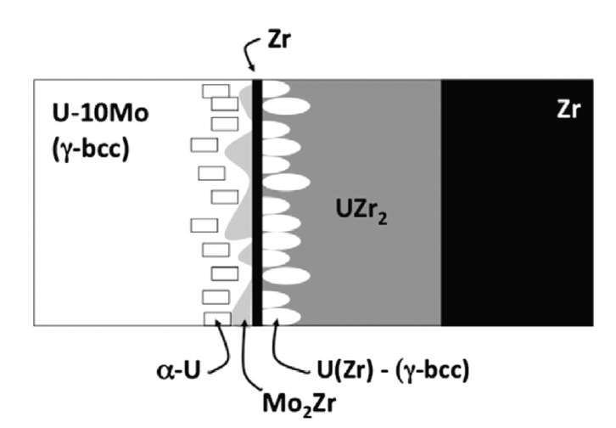
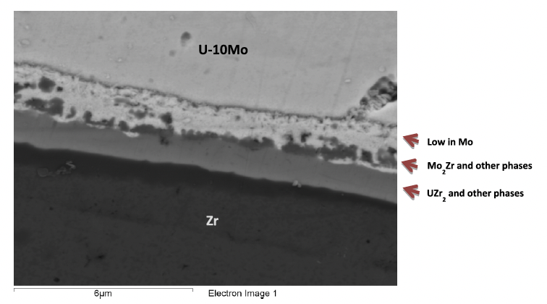
Interaction Layer
The U-Mo/Zr interface contains multiple phases that develop during the interdiffusion that occurs between U-10Mo and Zr during the co-rolling and HIP processes
Phases observed near the U-10Mo interface with the Zr diffusion barrier include: UZr2, gamma-UZr, Zr solid solution, Mo2Zr phases, and small amounts of alpha-U were also observed in the Mo depleted zone that forms

Slide 7
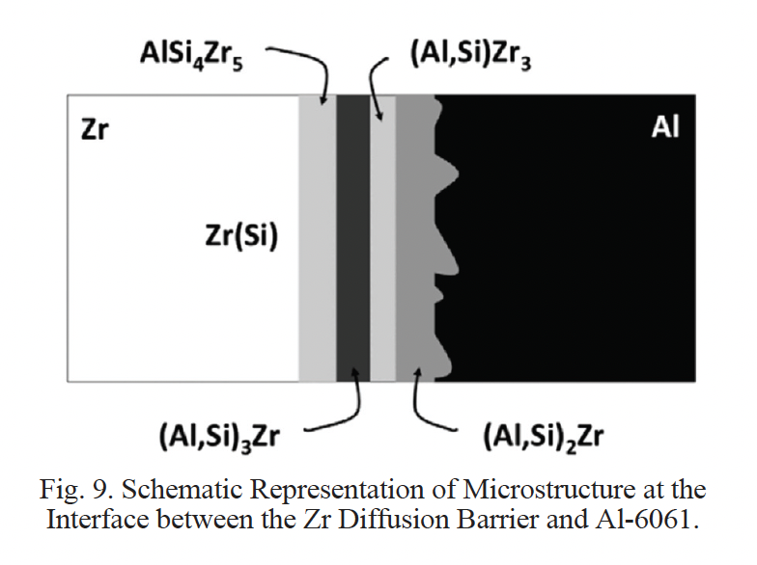
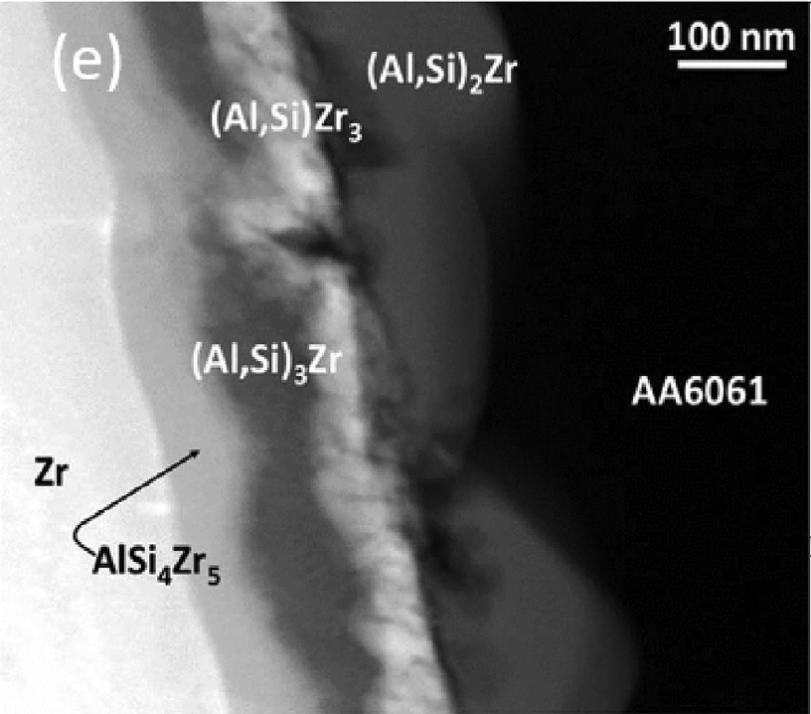
Zr/Al Interaction Layer
The Zr/Al-6061 cladding interface must also be well-bonded and stable
This multi-phase zone develops during HIP processing
Ten different binary Al-Zr intermetallic compounds exist, however, not all form
Si interacts with the Al-Zr system to form four distinctive layers AlSi4Zr5, (Al,Si)Zr3, (Al,Si)3Zr and (Al,Si)2Zr
Interdiffusion layer can be limited by processing at lower temperatures

Slide 8
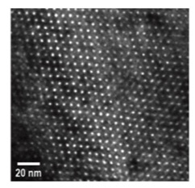
Monolithic Irradiation Behavior
The key phenomena that affect the dimensional stability of a monolithic fuel plate during irradiation are fuel swelling, phase transformation under irradiation, radiation-enhanced diffusion resulting in the formation of unstable phases, creep of materials, and mechanical-property degradation
These are similar to dispersion fuels, with the difference of a single connected fuel system and the potential for macroscale changes
Fuel swelling undergoes the fission gas superlattice formation, and subsequent recrystallization (and FGS destruction) leading to accelerated swelling
Solid fission product swelling occurs in the same manner as with other intermetallic fuels

Slide 9
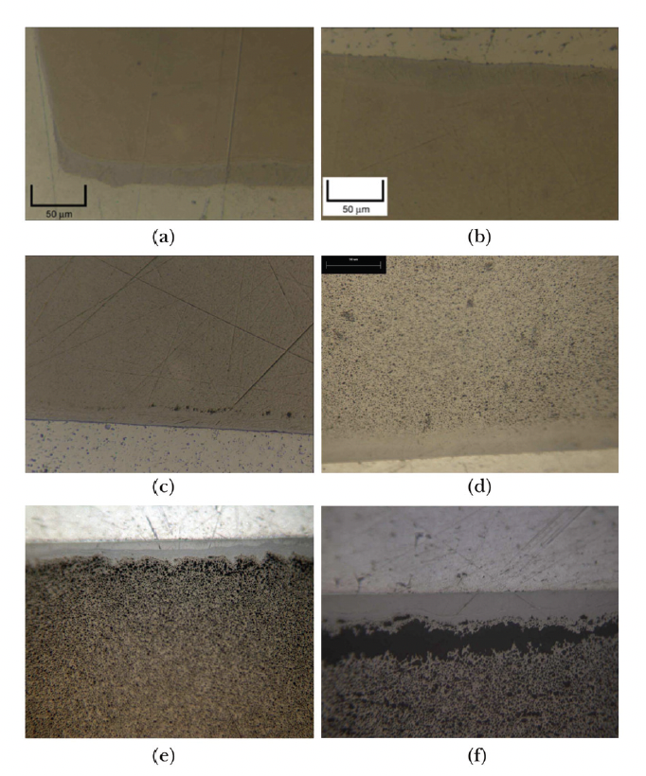
Microstructure Evolution
At fission densities in the range of 2.2E27 to 4.0E27 f/m3, little microstructural change is apparent using OM
As fission density increases from 4.0E27 f/m3 to 6.2E27 f/m3, grain refinement occurs, and formation of micron-scale porosity is visible in some regions near the U-Mo/Zr interface
At a fission density of 7.2E27 f/m3, grain refinement has occurred throughout the majority of the microstructure
Delamination of the fuel near the U-10Mo/Zr interface occurs at a local fission density of 9.5E27 f/m3
Fission Density
(a) 2.2, (b) 4.0,
(c) 6.2, (d) 7.2, (e) 8.4, (f) 9.5

Slide 10
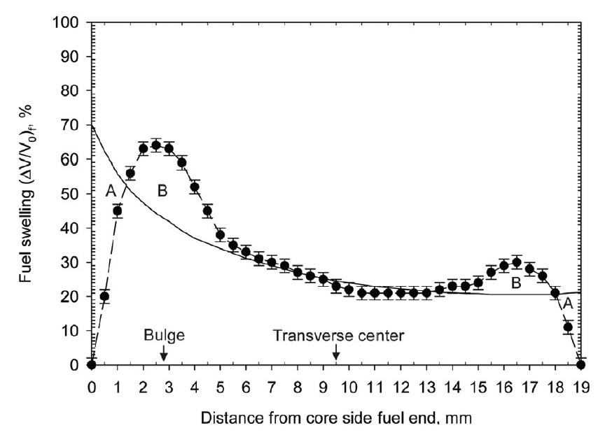
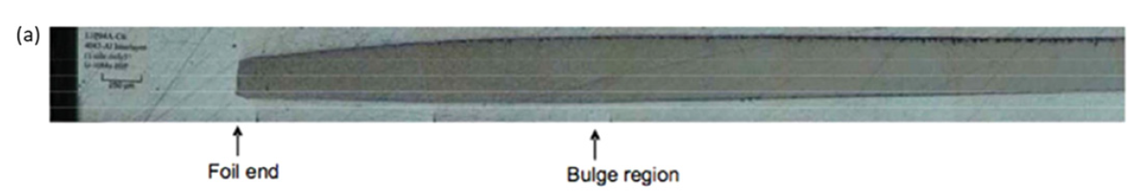
Creep and Peaking
Irradiation enhanced creep is a key phenomenon that makes the monolithic fuel system viable
Fuel foils are constrained from swelling in the plane of the fuel plate by the cladding rails, and examination of irradiated fuel plates shows that little or no dimensional change is measured in this plane
Plate failures occur in the regions of the fuel plates with the highest fission density
Peaks in fission density are caused by power peaking at the ends and edges of fuel plates in this test configuration

Slide 11
Creep Forming Bulges
The formation of this thick region can be explained by irradiation enhanced creep of the fuel driven by the stress that builds up at the rail constraint caused by fission product swelling
Swelling at the plate edges is lower than expected, due to the constraint of the plate rail
Fuel moves inward by irradiation-enhanced creep to form the thick region approximately 3 mm from the edge of the foil
While there is a creep correlation to predict this dimensional change, very little is known about U-Mo creep

Slide 12
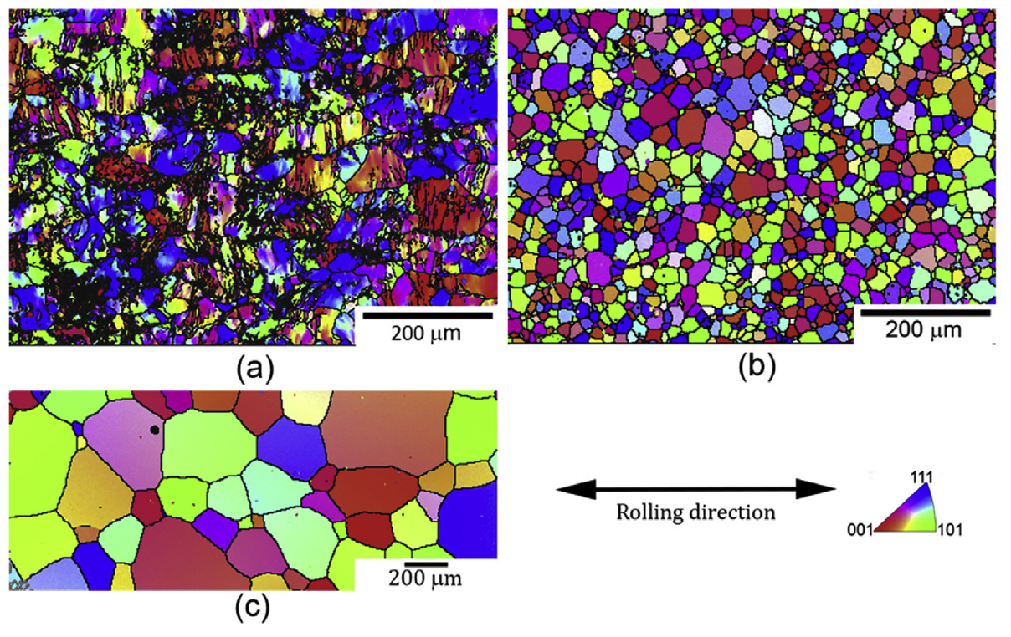
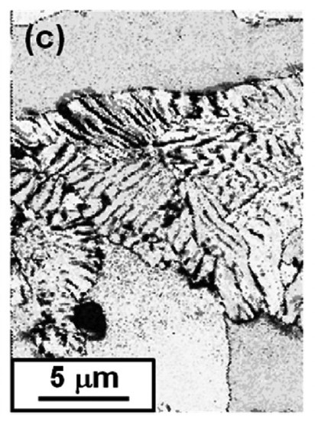
Effect of Fabrication on Microstructure
The rolling process can degrade the gamma phase, inducing phase decomposition
The eutectoid decomposition initiates when alternate lamellar structures, consisting of alpha-U and gamma-U with higher Mo content than the matrix (or potentially U2Mo), forms in U-Mo fuel
The lamellar structure tends to nucleate primarily along the prior gamma-UMo grain boundaries, but nucleation on deformation bands inside of the grains has been noted as well

Slide 13
Effect of Fabrication on Microstructure
When the as-rolled material is subjected to annealing (heat treatment), the grains relax internal stresses
Grain size distribution of U-10Mo fuel widens with an increase in annealing temperature, likely due to pinning from precipitates
Homogenization of the microstructure must be weighed against cost of high temperature fabrication processes
(a): as-rolled (b) rolled and annealed at 700C and (c) rolled and annealed at 1000C

Slide 14
Microstructure Effects on Performance
When the decomposed regions revert back to gamma-UMo, a perfect phase transformation is not possible, and a network of dislocations is left in the gamma-UMo matrix
This increased dislocation density has been experimentally associated with grain refinement zones
Thus, with an increase in the decomposed regions in the as-fabricated fuel, there are a) additional nuclei for grain refinement; or b) accumulated damage in localized regions, lowering the threshold for grain refinement

Slide 15
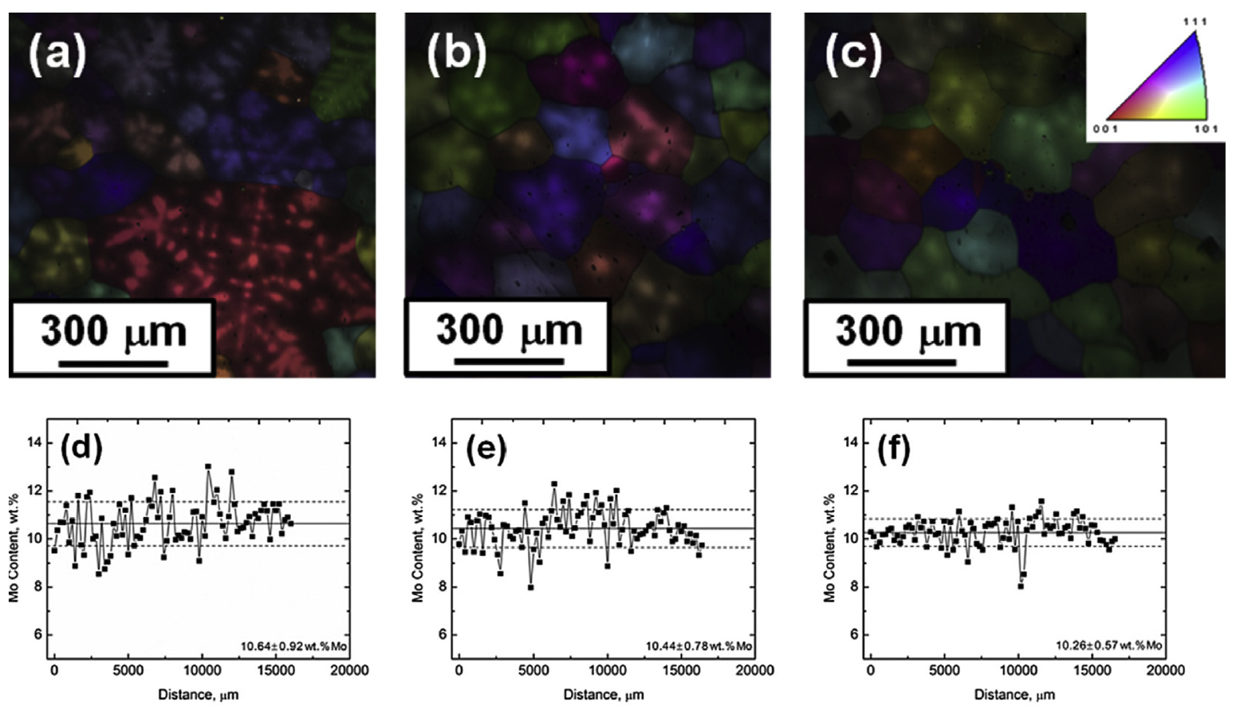
Chemical Homogeneity
Due to the solidification process, similar to atomization, Mo rich regions will solidify first, and Mo depleted grain edges/boundaries will form
Decomposition is more likely in Mo-lean areas, due to the phase diagram
Homogenization processes can be performed (high T annealing) to reduce the chemical gradients
Mo concentration gradients change with the homogenization temperature
a, b, c denote different heat treatments

Slide 16
Microstructural Modeling of UMo
Lower length scale modeling in the USHPRR program was initiated in 2015 to mitigate risks associated with unknown behaviors of UMo fuel
The AFIP6-MkII experiment exhibited early onset breakaway swelling which did not fit with previous experimental efforts
LLS modeling can explore fundamental phenomena to obtain mechanistic predictions of fuel behavior

Slide 17
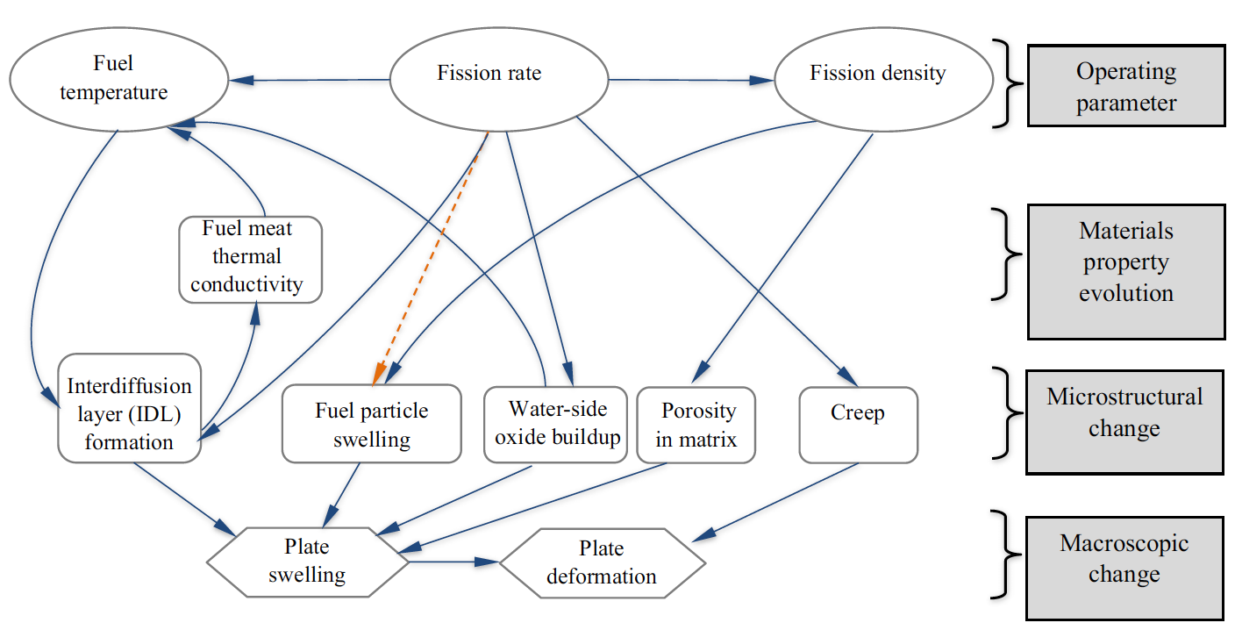
Microstructural Modeling of UMo
The major physical processes impacting RTR fuel performance are intricately related
The key four classes of physical processes: operating parameters, fuel microstructural and materials property changes, and dimensional changes of the fuel plate
Microstructural change is the result of the irradiation behavior of fuel plates

Slide 18
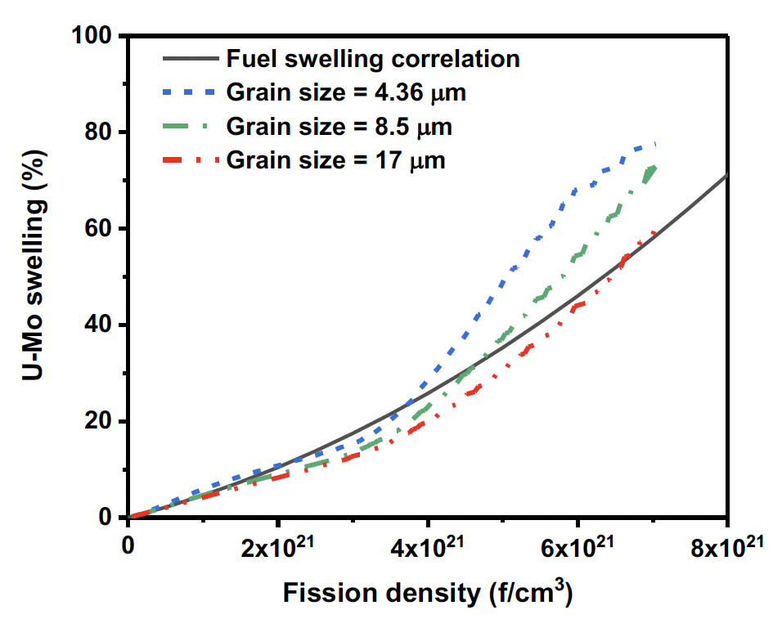
Grain Size Effects on Swelling
Grain size can affect the rate and magnitude of swelling
Initial grain size impacts the rate at which the FGS is destroyed
The initial conditions for which intergranular bubbles and new grains can nucleate are define by as fabricated grain size
The continuing rate of grain refinement is also governed by initial grain size

Slide 19
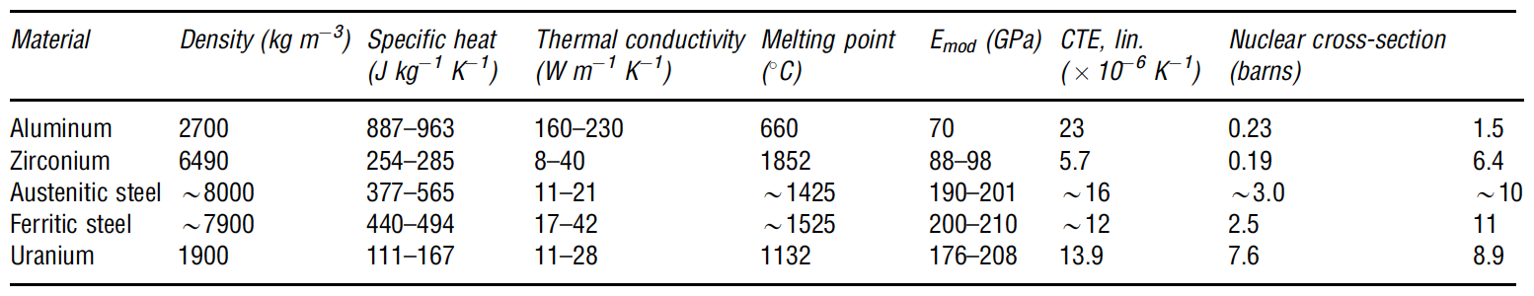
Aluminum in Research Reactors
Aluminum alloys are generally too weak or have temperature limitations that preclude their use in commercial reactors
In most research reactors where bulk water coolant temperatures are usually <100C, aluminum alloys are quite comfortable and are universally employed

Slide 20
Aluminum Benefits
Al is ductile, plentiful, cheap, and light weight
It is castable, machineable, and weldable, and it can be shaped readily by conventional processes
It has good water corrosion resistance due to near-insolubility in water and formation of a passive, self-restoring surface film of hydrated aluminum oxide
It has an fcc crystal structure and no crystallographic phase changes, with near isotropic properties
It can be strengthened by cold work, solid solution hardening, and precipitation treatments
At low temperatures, it has no ductile-to-brittle transition
It is also resistant to hydriding

Slide 21
Aluminum Drawbacks
Al has a low elastic modulus and low melting temperature
The low melting temperature of 660C imposes operating temperature limits of 100–150C
The strength condition of prehardened alloys can become compromised at temperatures above 150C and Al alloys become substantially more susceptible to creep above 150C

Slide 22
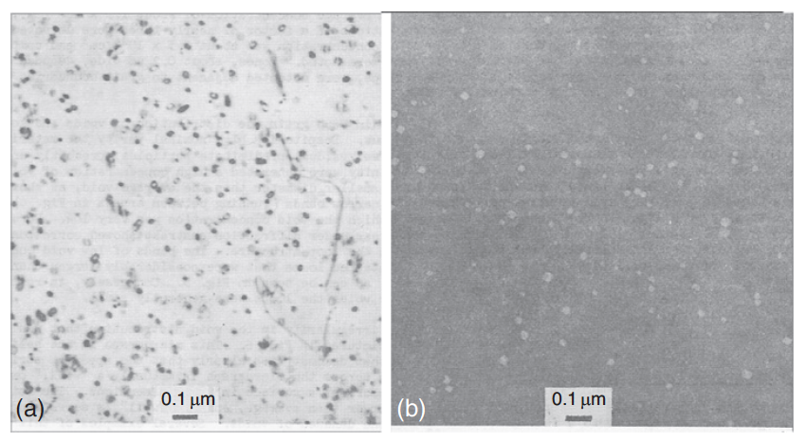
Damage Microstructure
Dislocation loops (a) and voids (b) in high-purity aluminum after irradiation at 50C to a fluence of 3.5E24 n/m2
The loops and voids are of order 30 nm diameter
In typical nuclear cladding materials, under similar temperature and neutron fluence conditions, the radiation damage microstructure is resolvable as 1–2 nm black dots

Slide 23
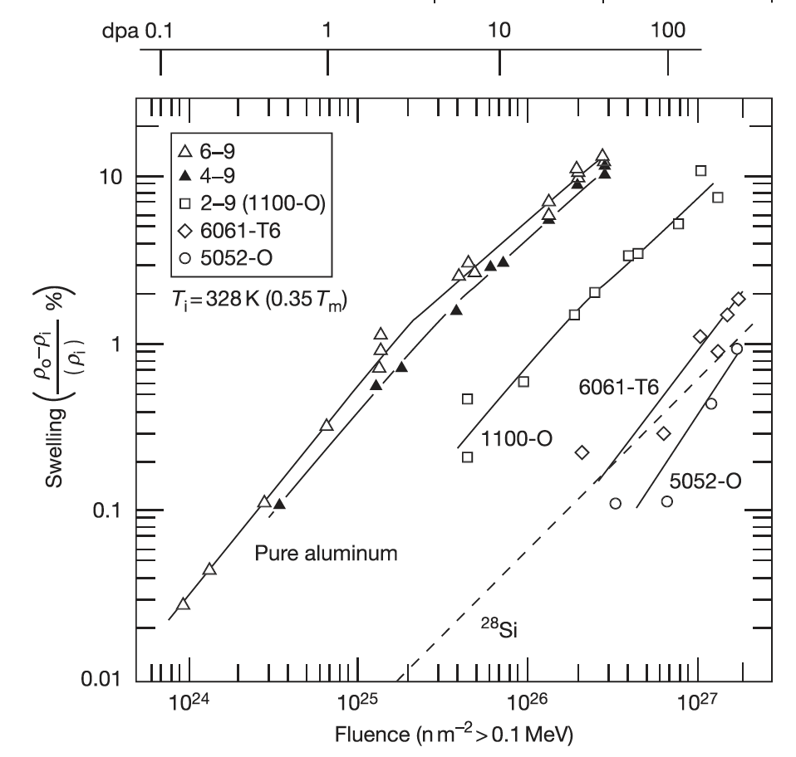
Swelling
Swelling is due to the accumulation of voids from excess vacancies
Gas bubble swelling is generally not an issue for Al in RRs because the temperature is too low
The 6061 alloy, with its inherent Mg2Si phase, starts swelling appreciatively later in dose than the 1100-O or pure Al
Swelling is limited to less than 1% for the higher levels of fluence expected in RRs

Slide 24
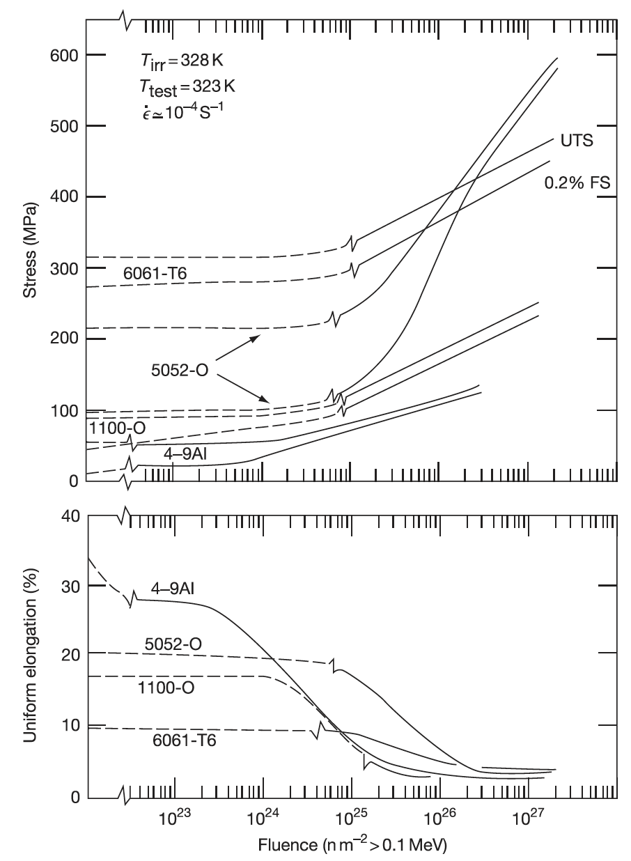
Hardening
The major consequences of radiation damage structures on the mechanical properties of Al alloys are radiation hardening and associated loss in ductility
Al6061 is generally a stronger alloy than comparable Al alloys
Hardening and reduction in elongation occur at approximately 1E25 n/m2, with as much as a 2X (1/2X) effect on the associated property

Slide 25
Summary
The Zr interdiffusion barrier prevents U-Mo-Al interaction, but creates new interaction layers with a series of phases present
U-Mo fuel creeps, creating a bulge just inside the edge of the fuel
Decomposed regions can accelerate grain refinement and swelling and can be reduced through chemical homogenization and annealing
Fuel fabrication specifications can dramatically affect the microstructure and thus the performance of the fuel – this is more critical for monolithic fuels
Microstructural modeling is attempting to describe the variety of governing phenomena in U-Mo fuel
Al is ideally suited for the research reactor environment with its excellent corrosion and swelling resistance at applicable temperatures

